Slide 1

Workpshop
Roberto Abarca

Slide 2
BUILD ?
Build is a social platform
APP Prototyping, no UI experience.
Test your idea for the design of an app without having to code
evaluate if a design would be accepted
It’s basically created to be of help in UX design testing.

Slide 3
DESIGN THINKING
Is a new, fresh way of engaging with SAP to find human meaning and use for technology.
Helps you think differently about:
Business & Pain points
Explore the unknown
Innovate.

Slide 4
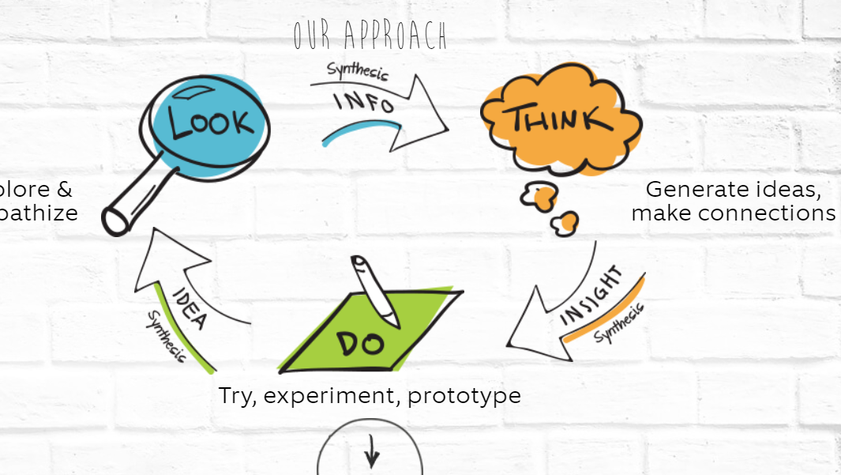
How it works

Slide 5
What is User Experience as a Service?
It empowers organizations to create and scale a simple, personalized and responsive user experience.
It guides users through the innovation life cycle while staying entirely within the SAP ecosystem.
https://vimeo.com/sapux/build

Slide 6
BEFORE YOU START
Who are you designing for?
Define the User
Give the persona a name
Create a short quote
Outline needs & Goals
Validate your persona with your end users.

Slide 7
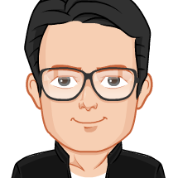
RODRIGO
Customer Relationship Manager
About him
35, married, 5 years of experience.
Always on the go, keeping track of what customer’s need and our ability to meet those expectation.
Very mobile, always in touch with the customers.
Job Responsibilities. -
Responsible for customer’s orders and shipments.
Ensuring product stock is adequate for all distribution channels and can cover direct demand from customers.
Needs.-
I always need to know the list of our customers and their open orders.
I need to know the delivery date for each customer, so I can schedule it properly.
I need to know the customers contact name and their current level of debt.
Main Goals. -
Track the customer’s orders and supply them on the right time.
Maintain long-term, post-sales relationships with existing customers across a wide selection of companies and industries.
To ensure deliveries and customer satisfaction with each order.
Pain Points.-
Can’t check customer’s information quickly.
The order sheet is very complex, and very time consuming.
Need to quickly approve each customer’s orders.

Slide 8
More on BUILD and Design thinking ?
https://blogs.sap.com/2016/11/03/build-overview/
1
https://designthinkingwithsap.com/en/
2

Slide 9
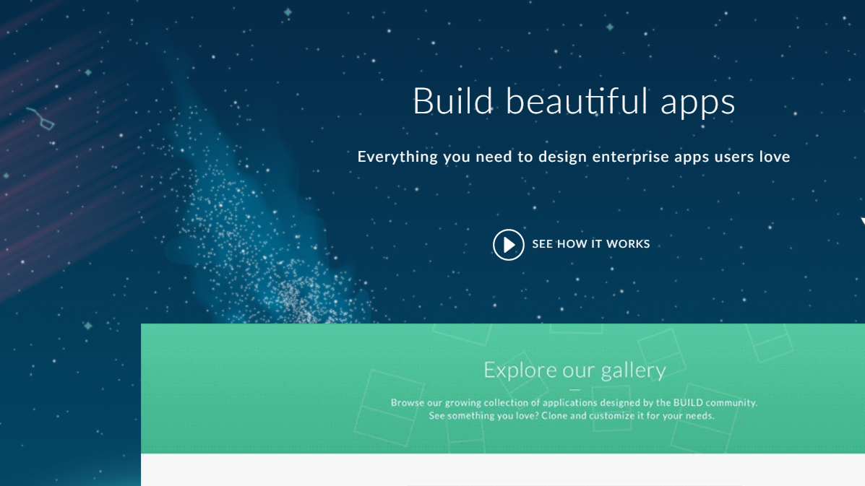
How to start?
Please log in:
https://www.build.me/splashapp/

Slide 10
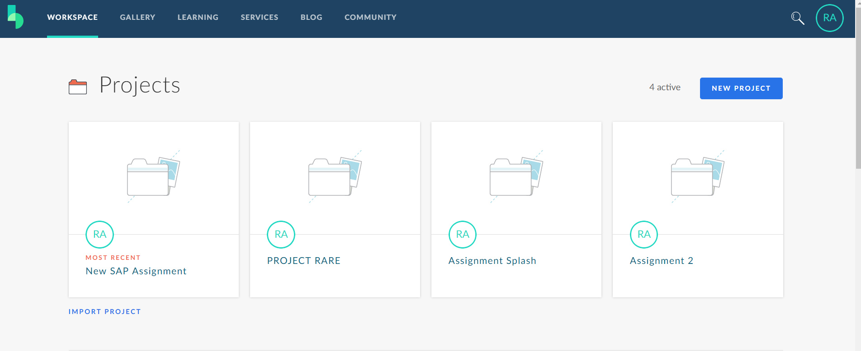

Slide 11
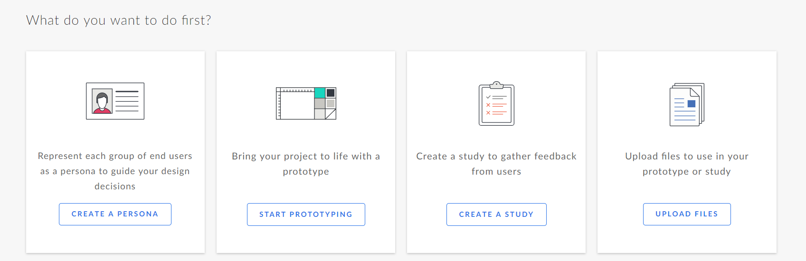
STEP 1: Start Prototyping

Slide 12
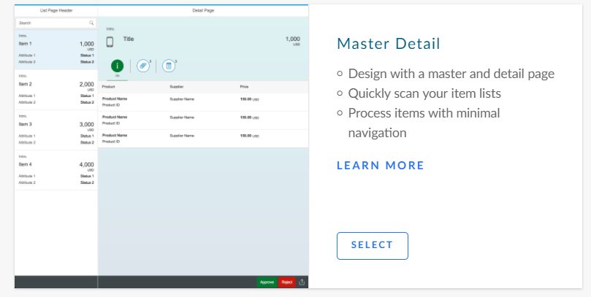

Slide 13
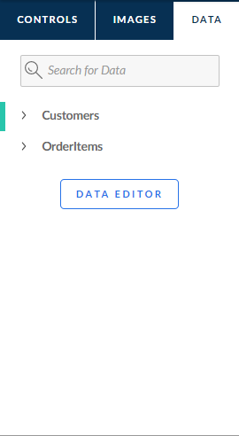

Slide 14
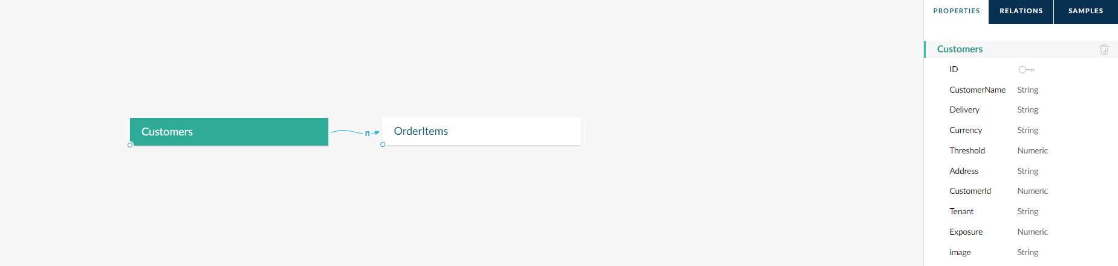

Slide 15
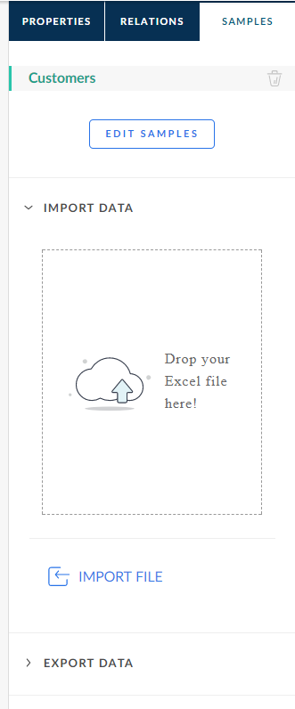

Slide 16
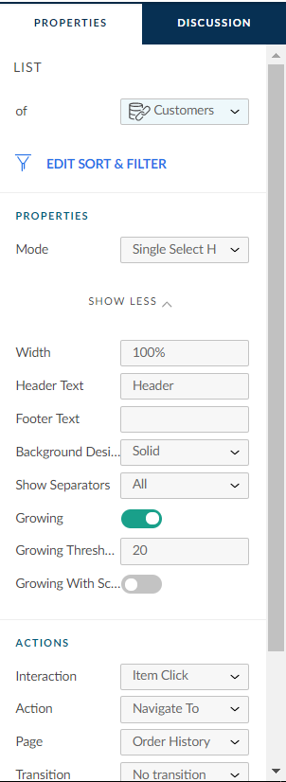

Slide 17
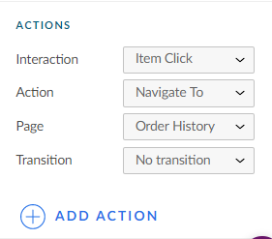

Slide 18
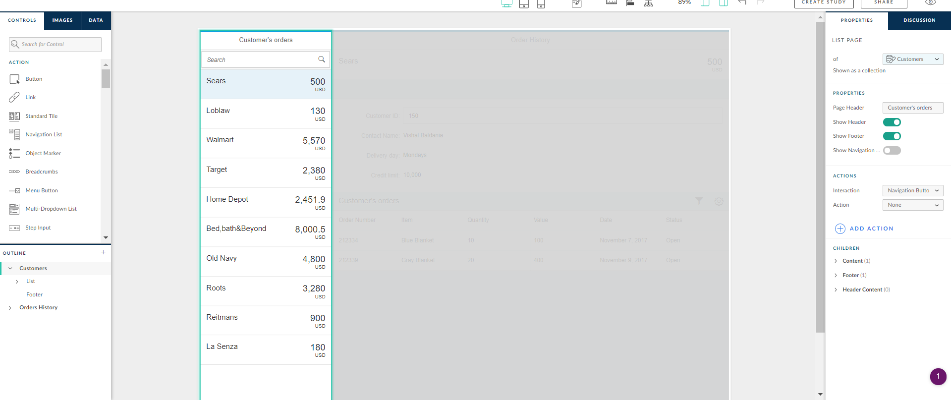

Slide 19
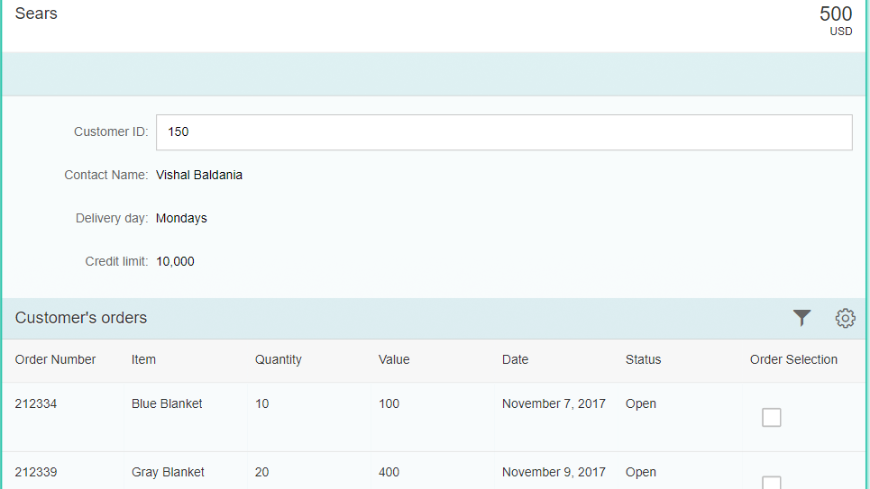

Slide 20
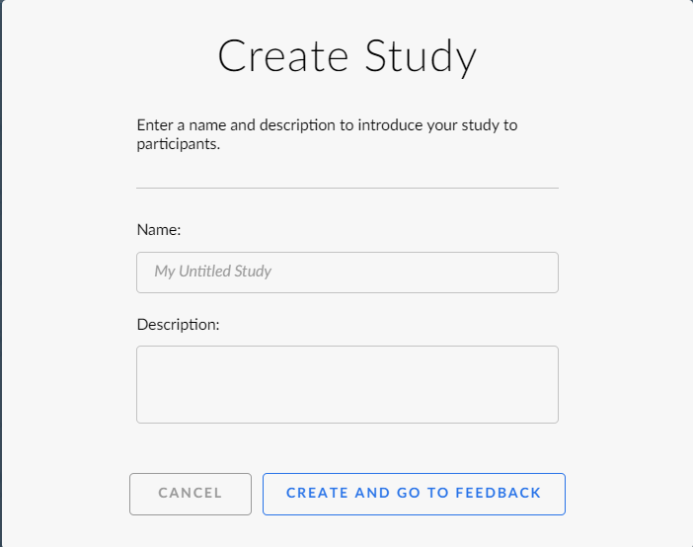

Slide 21
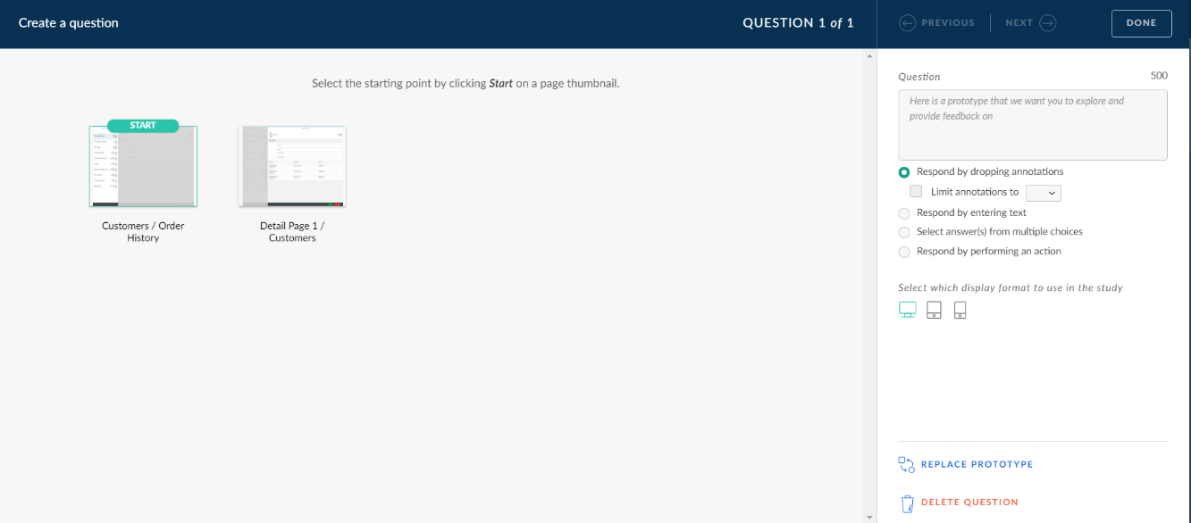

Slide 22
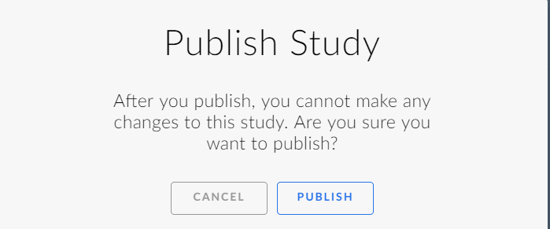

Slide 23
